Slide 1
8
Social
Computing

Slide 2
CHAPTER OUTLINE
Web 2.0
Fundamentals of Social Computing in Business
Social Computing in Business: Shopping
Social Computing in Business: Marketing

Slide 3
CHAPTER OUTLINE
Social Computing in Business: Customer Relationship Management
Social Computing in Business: Human Resource Management

Slide 4
Describe six Web 2.0 tools and two major types of Web 2.0 sites.
Describe the benefits and risks of social commerce to companies.
Identify the methods used for shopping socially.
Discuss innovative ways to use social networking sites for advertising and market research.

Slide 5
Describe how social computing improves customer service.
Discuss different ways in which human resource managers make use of social computing.

Slide 6

Disappearing Images
Describe the advantages and disadvantages of Snapchat to its users. Provide specific examples of both to support your answer.
Do you think that Snapchat can become profitable (i.e., survive) in the marketplace? Why or why not? Support your answer with specific examples.
How will the Snapchat breach affect marketers who are considering using the app in their campaigns?
Should Snapchat’s founders have sold the service to Facebook or Google? Why or why not? If you were the founder of Snapchat, would you have accepted one of these offers? Why or why not?

Slide 7
’S ABOUT BUSINESS 8.1
Brian Krebs Blogs on Information Security
List various ways in which Krebs can make money from his blog.
You are the Chief Security Officer for a company. How would you incorporate Krebs’s blog into your security efforts?

Slide 8
8.1
Web 2.0
AJAX
Tagging
Folksonomies
Geotagging
Really Simple Syndication (RSS)
Blogs
Notes:
AJAX: is a Web development technique that enables users to reload portions of Web pages with fresh data instead of having to reload the entire Web page.
Tagging: a keyword or term that describes a piece of information—for example, a blog, a picture, an article, or a video clip. Tagging allows users to place information in multiple, overlapping associations rather than in rigid categories.
Folksonomies: user generated classifications that use tags to categorize and retrieve Web pages, photos, videos, and other Web content.
Geotagging: a specific form of tagging referring to tagging information on maps (example: Google Maps allows users to add pictures and information, such as restaurant or hotel ratings, to maps).
Blog: (short for weblog) a personal Web site, open to the public, in which the site creator expresses his or her feelings or opinions via a series of chronological events.

Slide 9
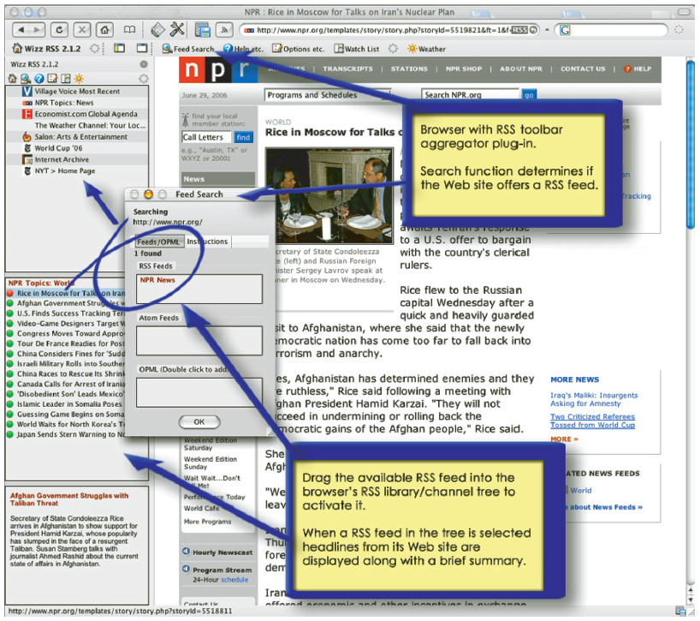
Figure 8.1: Web Site of National Public Radio with RSS Toolbar

Slide 10

8.1
Web 2.0 (continued)
Microblogging
Wikis
Social Networking Web Sites
Enterprise Social Networks
Mashups
Notes:
Microblogging: a form of blogging that allows users to write short messages (or capture an image or embedded video) and publish them (Example: Twitter).
Wiki: a Web site made up entirely of user generated content (Example: Wikipedia.com).
Social Network: a social structure composed of individuals, groups, or organizations linked by values, visions, ideas, financial exchange, friendship, kinship, conflict, or trade.
Social Networking: refers to activities performed using social software tools (e.g., blogging) or social networking features (e.g., media sharing).
Social Graph: the map of a single member of a social network comprised of all relevant links or connections among the greater social network.
Social Capital: refers to the number of connections an individual person has within and between social networks.
Social Networking Web Sites: web sites that allow participants to create their own profile page for free allowing them to post blog entries, pictures, video, music and/or share ideas.
Enterprise Social Networks: business-oriented social networks (public or private) designed to support networking and community building, social collaboration, social publishing, Social intelligence and social analytics.
Mashups: a Web site that takes different content from a number of other Web sites and mixes them together to create a new kind of content.

Slide 11
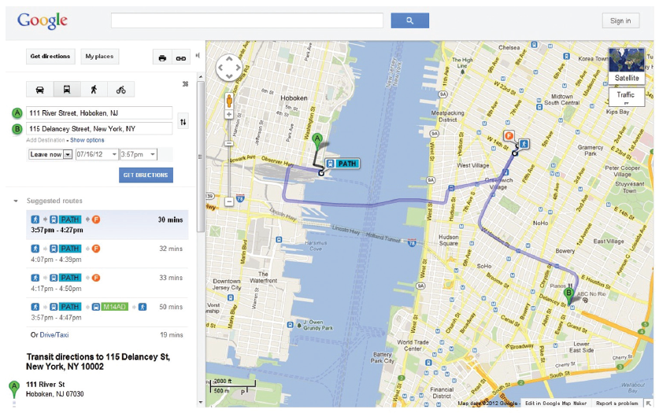
Figure 8.2: Google Maps is a Classic Example of a Mashup

Slide 12
8.2
Fundamentals of Social Computing in Business
Social Commerce
Benefits to customers
Benefits to businesses
Notes:
Social Commerce: the delivery of electronic commerce activities and transactions through social computing. Social commerce also
supports social interactions and user contributions, allowing customers to participate actively in the marketing and selling of products and services in online marketplaces and communities.
-- Benefits to Customers
-- Benefits to

Slide 13
Social Commerce: Benefits to Customers
Better and faster vendor responses to complaints (on Twitter, Facebook, and YouTube)
Customers can assist other customers (e.g., in online forums)
Customers’ expectations can be met more fully and quickly
Customers can easily search, link, chat, and buy while staying on a social network’s page

Slide 14
Social Commerce: Benefits to Businesses
Can test new products and ideas quickly and inexpensively
Learn a lot about their customers
Identify problems quickly and alleviate customer anger
Learn about customers’ experiences via rapid feedback
Increase sales when customers discuss products positively on social networking site

Slide 15
Social Commerce: Benefits to Businesses (Con’t)
Create more effective marketing campaigns and brand awareness
Use low-cost user-generated content, for example, in marketing campaigns
Obtain free advertising through viral marketing
Identify and reward influential brand advocates

Slide 16
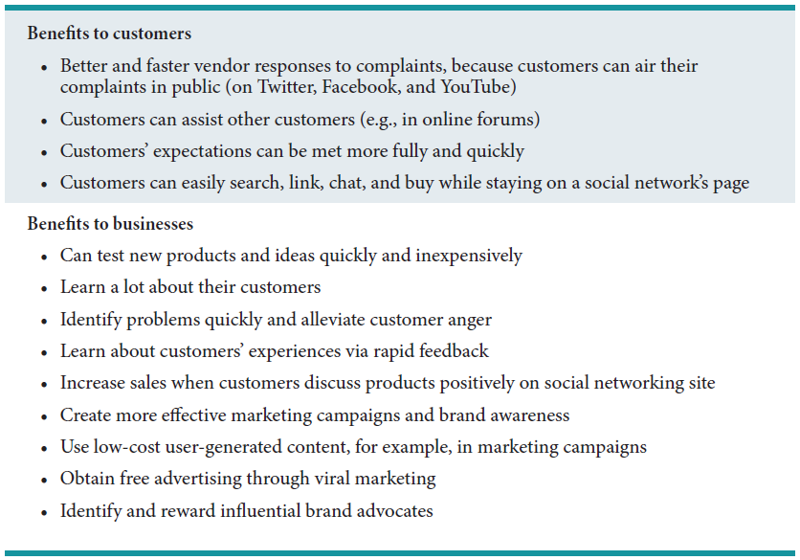
Table 8.2: Potential Benefits of Social Commerce

Slide 17
’S ABOUT BUSINESS 8.2
Trip to Europe: Cancelled
Should you be careful of what you post on Facebook? Support your answer in relation to this case.
What mistake did the parents make when they informed Dana about the settlement? Telling her at all? Not telling her about the dangers of posting details on social media?

Slide 18
8.3
Social Computing in Business: Shopping
Ratings, Reviews, and Recommendations
Group Shopping
Shopping Communities and Clubs
Social Marketplaces and Direct Sales
Peer-to-Peer Shopping Models
Notes:
Ratings, Reviews, and Recommendations: are usually available in social shopping and generally come from,
(a) Customer ratings and reviews integrated into the vendor’s Web page
(b) Expert ratings and reviews from an independent authority
(c) Sponsored reviews: paid-for reviews
(d) Conversational marketing: individuals converse via e-mail, blog, live chat, discussion groups, and tweets.
Group Shopping: Web sites such as Groupon and LivingSocial offer major discounts or special deals during a short time frame.
Shopping Communities and Clubs: host sales for their members that last just a few days and usually feature luxury brands and heavily discounted prices. These clubs tend to be exclusive and help sell luxury items without watering down the brands’ images.
Social Marketplaces and Direct Sales: act as online intermediaries that harness the power of social networks for introducing, buying, and selling products and services. A social marketplace helps members market their own creations.
Peer-to-Peer Shopping Models: are the high-tech version of oldfashioned bazaars and bartering systems. Individuals use these models to sell, buy, rent, or barter online with other individuals.
Collaborative consumption: peer-to-peer sharing or renting.

Slide 19
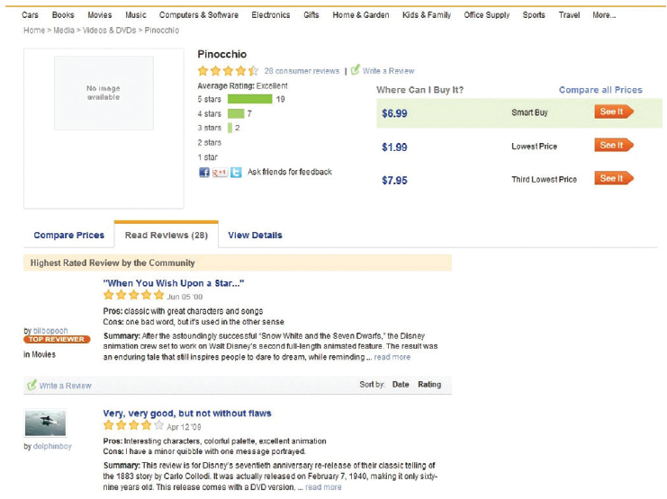
Figure 8.3: Epinions is a Web site that allows customers to rate anything from cars to music.

Slide 20
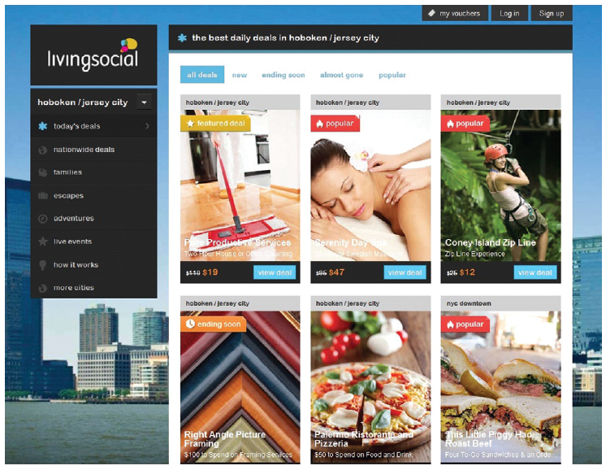
Figure 8.4: LivingSocial.com is a Popular Example of a Group Shopping Web Site.

Slide 21

Figure 8.5: Etsy.com is a Social Marketplace for all Handmade or Vintage Items.

Slide 22
’S ABOUT BUSINESS 8.3
Social Network Analysis Applied to Gangs
What other data could the Chicago Police Department add to ORCA?
What are the potential disadvantages of ORCA? Provide specific examples to support your answer.

Slide 23
8.4
Social Computing in Business: Marketing
Social Advertising
Market Research
Conversational Marketing
Conducting Market Research Using Social Networks
Notes:
Social Advertising: refers to the advertising formats that make use of the social context of the user viewing the ad. It is the first form of advertising to leverage forms of social influence such as peer pressure and friend recommendations and likes.
Market Research: today members of social media voluntarily provide demographics that help identify and target potential customers. Due to the open nature of social networking, merchants can easily find customers, see what they do online, and learn who their friends are.
Conversational Marketing: feedback from customers provided to companies through social computing tools (e.g., blogs, wikis, online forums, and social networking sites.
Conducting Market Research Using Social Networking: Customer sentiment expressed on Facebook, Twitter, LinkedIn and similar sites represent an incredibly valuable source of information for companies allowing them to analyze the data, conduct better advertising campaigns, improve their product design and their service offerings.

Slide 24
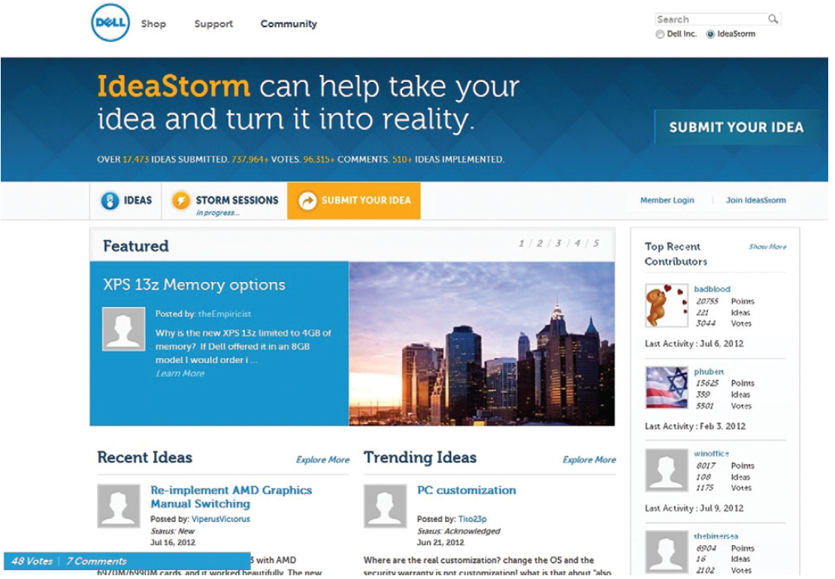
Figure 8.6: Customers Share Their Ideas and Feedback with Dell via IdeaStorm.com.

Slide 25
’S ABOUT BUSINESS 8.4
YouTube versus Television
Describe the differences in how traditional television and YouTube provide online content to audiences.
If you were the CEO of a traditional television network, how would you combat YouTube?

Slide 26
8.5
Social Computing in Business: Customer Relationship Management
How Social Computing Improves Customer Service
Notes:
Social computing has vastly altered both the expectations of customers and the capabilities of corporations in the area of customer relationship management.
Customers are now incredibly empowered as companies closely monitor negative comments and proactively involve customers to resolve problems/issues for improved customer service.
Empowered customers know how to use the wisdom and power of crowds and communities to their benefit.

Slide 27
8.6
Social Computing in Business: Human Resource Management
Recruiting
Employee Development
Notes:
Recruiting: Both recruiters and job seekers are moving to online social networks as recruiting platforms.
Employee Development: HR professionals are using enterprise social tools such as Chatter, Yammer, and Tibbr to enable, encourage, and promote employee development through relationship building by providing a platform for employees to collaborate on sales opportunities, campaigns, projects as well as simplify workflows and capture new ideas. Elearning and Etraining are employee development tools that can be leveraged through social computing.

